Slide 1



Using Big Data Analytics to Diagnose Breast Cancer
Vipin Kumar | Roll No: 24MBMB13 | University of Hyderabad — MBA (Business Analytics) | Platform: Databricks
Goal: Apply Big Data Analytics for early detection, diagnosis, and recurrence prediction of breast cancer using structured clinical data and unstructured pathology reports.

Slide 2

Project Overview — Objectives & Data
Primary Objectives
Detect cancer type (Benign vs. Malignant)
Rank diagnostic features (feature importance)
Reveal patient subgroups via clustering
Predict recurrence risk with ensemble models
Analyze pathology reports using NLP
Tools & Data — PySpark, Scikit-learn, Plotly, Seaborn, NLTK; Dataset: workspace.default.breast_cancer_big_data_dataset
Integrated dataset: structured clinical variables + free-text pathology reports (multimodal analysis).
Outcome: An integrated analytical approach that produces interpretable diagnostic signals and a baseline predictive framework for recurrence risk.

Slide 3
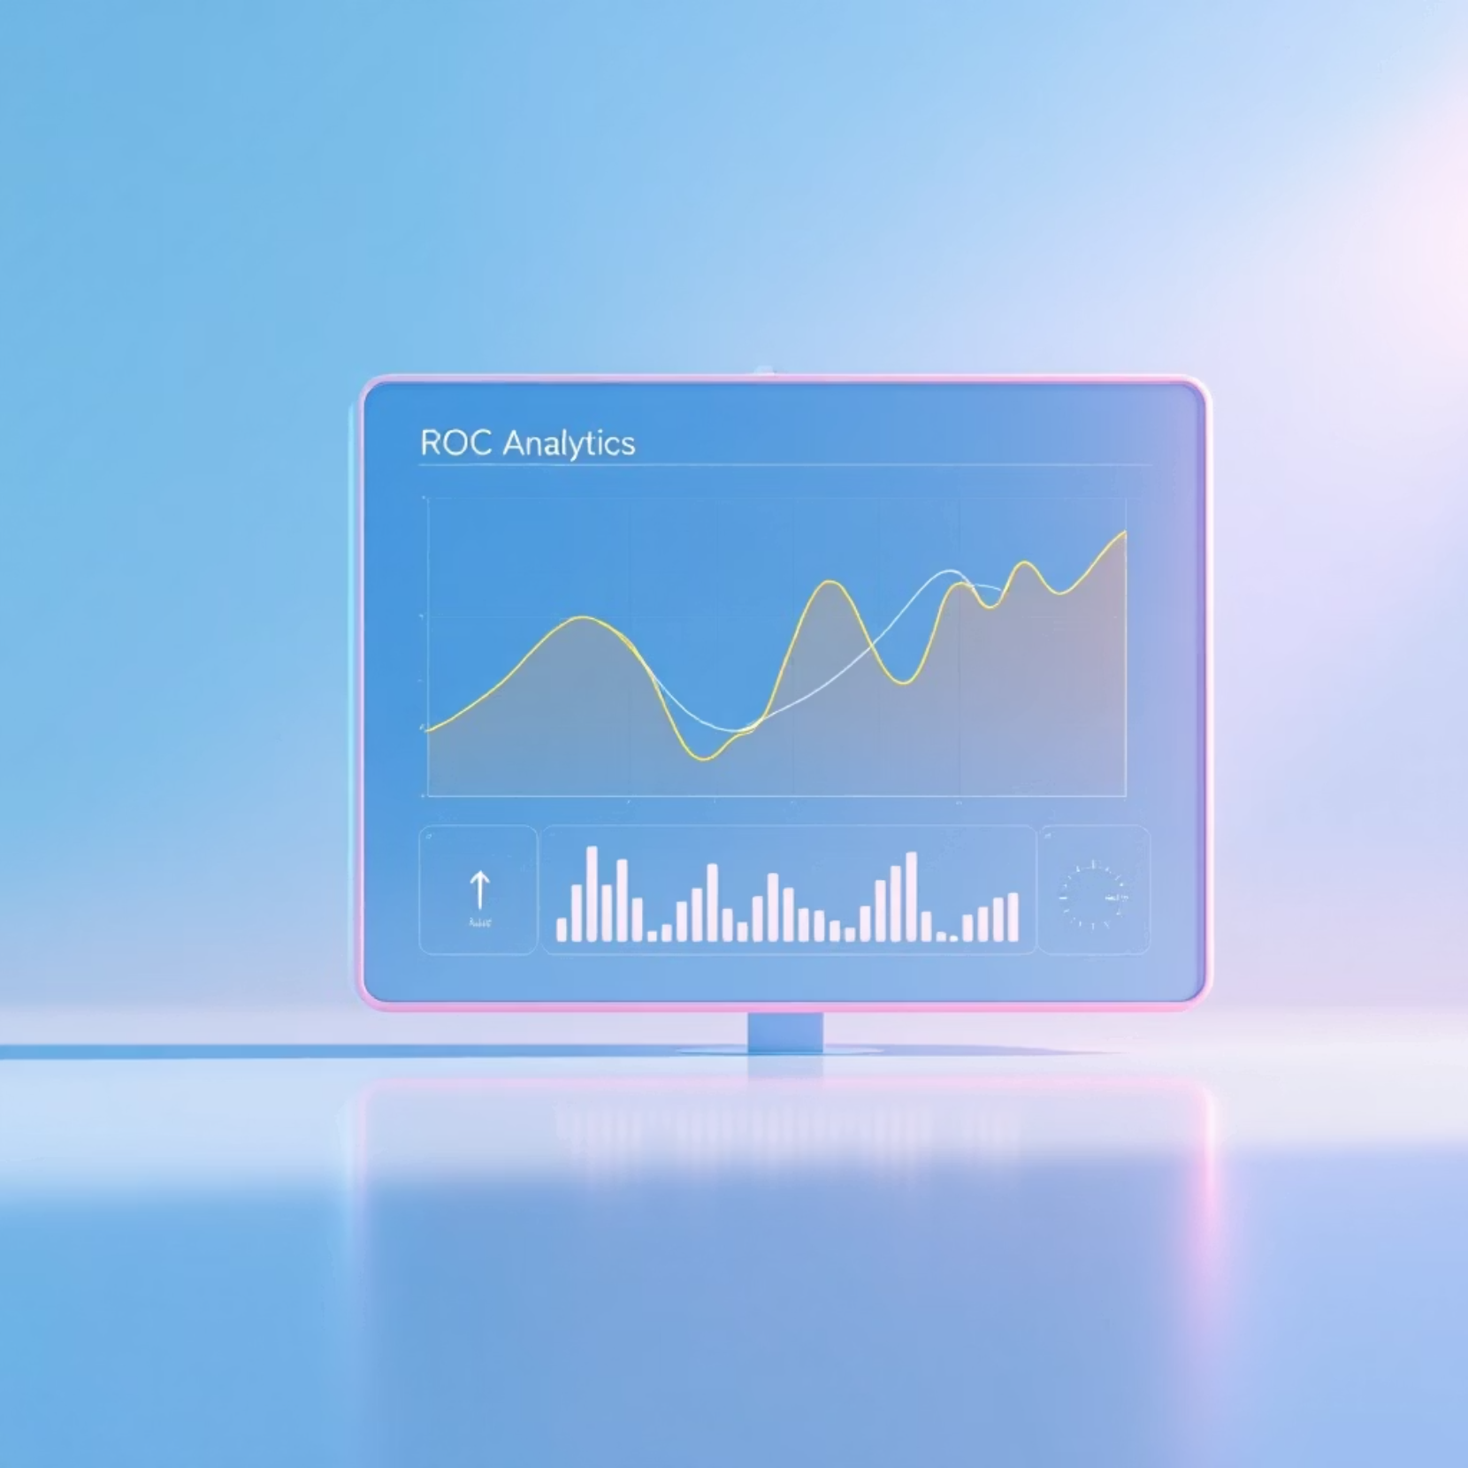
Case 1 & 2 — Classification and Feature Importance
Early Detection (Classification)
Models evaluated: Logistic Regression, Random Forest (RF). RF outperformed LR marginally but both show modest discrimination.
Accuracy — LR: 0.565 | RF: 0.580
ROC-AUC — LR: 0.484 | RF: 0.530
Key issue: Class imbalance produced low malignant recall — suggests need for resampling or class-weighted loss
Design implication: emphasize calibration, recall for malignant class, and model interpretability for clinical adoption.

Slide 4



Case 3 & 4 — Clustering Patterns and Recurrence Risk
0.0906
0.5071
Clustering (K-Means, k=3)
Recurrence Risk (Ensembles)
Silhouette: 0.0906 — partial separation but useful clinical patterns emerged: Cluster 0 (benign), Cluster 1 (borderline), Cluster 2 (malignant).
Random Forest AUC = 0.5018 | Gradient Boosted Tree AUC = 0.5071. Low AUC reflects limited recurrence labels and feature coverage.
Clustering uncovered progression patterns between benign and malignant morphology despite low separation metrics.
Top recurrence predictors: Tumor Size (mm), Mean Radius, Genetic Risk Score. Recommendation: integrate genomics and treatment history to improve predictions.

Slide 5
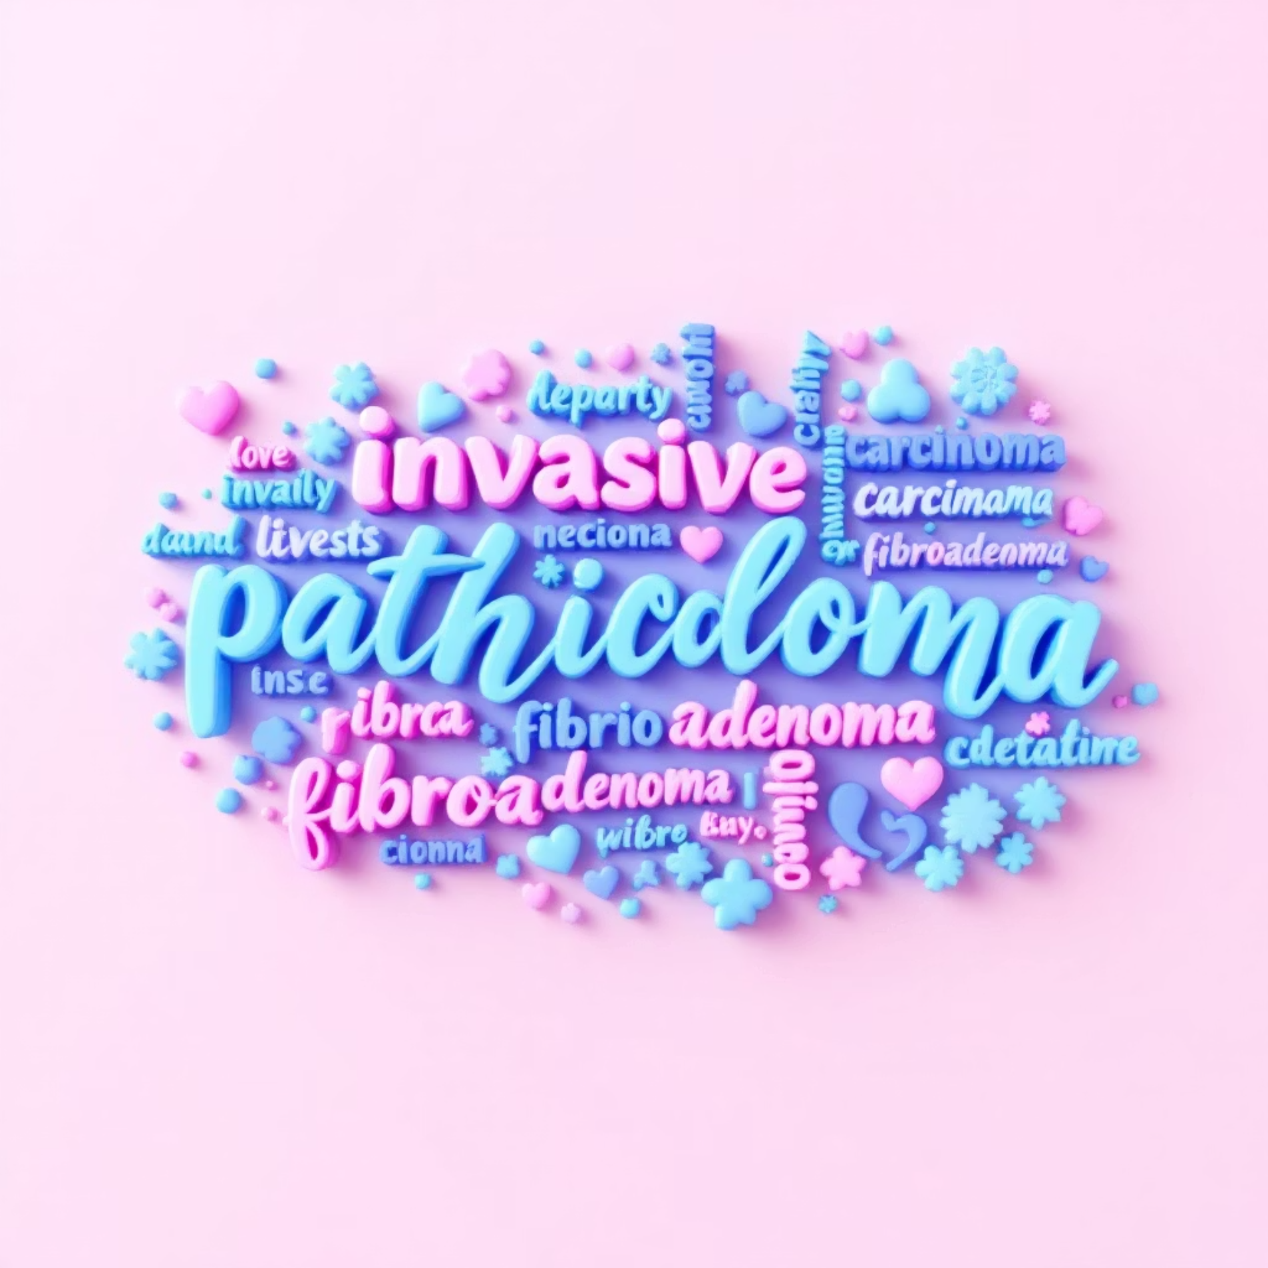
Case 5 — NLP on Pathology Reports & Synthesis
Text Model: TF-IDF + Logistic Regression
Accuracy: 0.58
ROC-AUC: 0.5831
Precision: 0.51 | Recall: 0.63 | F1: 0.56
Key terms distinguishing labels: malignant → "invasive", "carcinoma", "grade III"; benign → "fibroadenoma", "no atypia". Topic modeling produced 5 coherent topics (grading, invasion, structure, margins, cellularity).
Conclusions & Next Steps
Multimodal fusion (structured + text [+genomics]) improves diagnostic signal—recommend building a combined model pipeline in Databricks.
Address class imbalance (SMOTE, focal loss) and expand labeled recurrence data to lift AUC for recurrence prediction.
Advance NLP to contextual embeddings (Clinical BERT) and deploy an interactive clinical dashboard for interpretability.
"Data-driven analytics transforms medical diagnostics into actionable clinical intelligence."
Footer: Vipin Kumar — Roll No: 24MBMB13 | University of Hyderabad

